Slide 1

A Brief Introduction to F#

Slide 2
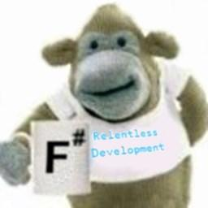
Me
Grant Crofton
Principal Software Developer, Callcredit
www.relentlessdevelopment.net
@relentlessdev
And more importantly…

Slide 3
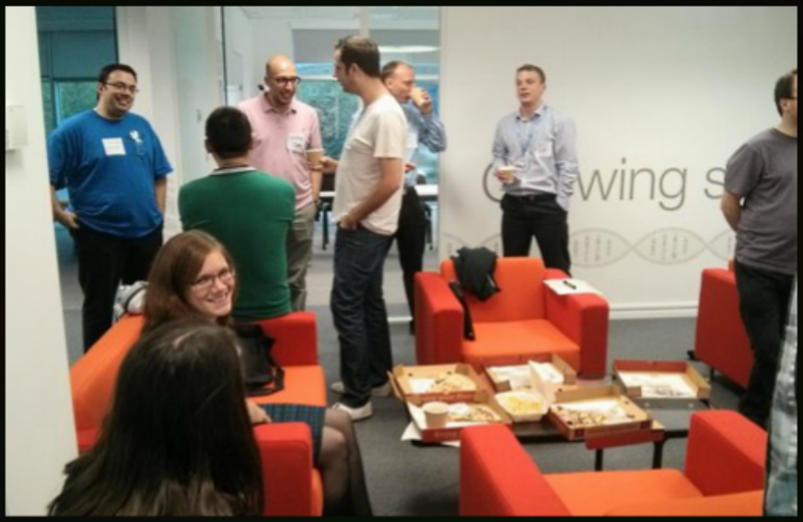

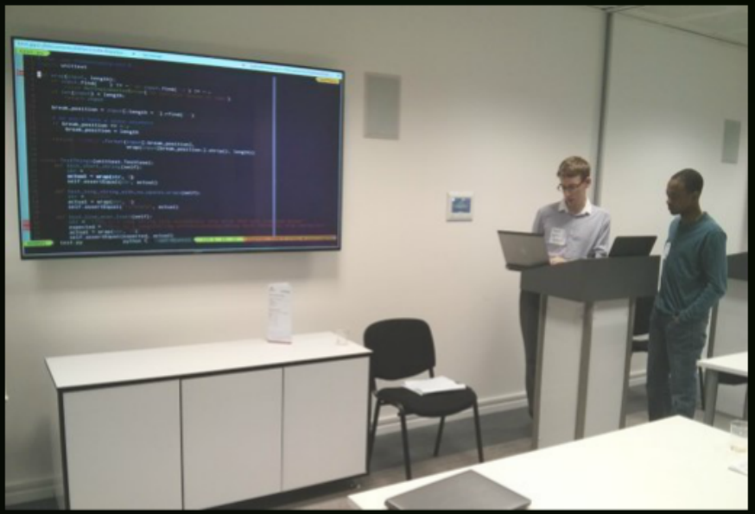
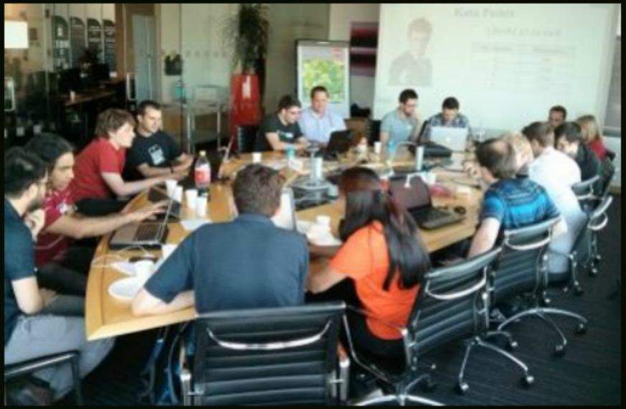
Leeds Code Dojo
LeedsCodeDojo.github.io
@LeedsCodeDojo

Slide 4




F# Timeline
2016: Voted best
language evar!..
2010: v2.0 included in
Visual Studio 2010
2014: F# reaches No. 12 on
Tiobe language index
2002: Started by Dr Don Syme at
Microsoft Research, Cambridge
2005: v1.0 released
2015: v4.0 released, with
¾ of new code contributed
by the community
2012: F# Software Foundation
Takes charge of the language,
maintaining libraries and
compiler under Apache 2.0
open source licence

Slide 5
F# Family Tree
Lisp
ML
Caml
OCaml
Elixir
Haskell
F#
R
C
C++
C#
C#

Slide 6







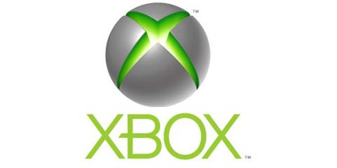
F# in the Real World

Slide 7
F# Language Facts
Functional First
Full OO capabilities
Immutable by default
Statically typed
Extensive type inference (Hindley-Milner)
Eager evaluation
Automatic generalisation (built-in generics)
Atomatic currying
Partial application
Compiles to .Net IL
Full access to .Net libraries & frameworks
No Nulls

Slide 8

Summary
Awesome!
F# =

